Slide 1





Regular Expressions (RegEx)
Advanced Text Manipulation
SoftUni Team
Technical Trainers
Software University
http://softuni.bg

Slide 2

Table of Contents
Regular Expressions
What are Regular Expressions?
Characters
Operators
Constructs
Regular Expressions in C#

Slide 3
Questions
sli.do #tech-softuni

Slide 4
Regular Expressions
Groups, Quantifiers, Anchors

Slide 5
Regular Expressions
Describe a search pattern
Can be used to extract data from text
[A-Z][a-z]+ [A-Z][a-z]+ - \w+@\w+\.\w+
matches
Ivan Ivanov – ivan@gmail.com
Petar Iotov – petar@abv.bg
Contact: Alex Georgiev – alex@mail.com...

Slide 6
Character Classes
[nvj] matches any character that is either n, v or j
[^abc] – matches any character that is not a, b or c
[0-9] - Character range: Мatches any digit frm 0 to 9
node.js v0.12.2
Abraham Lincoln
In 1519 Leonardo da Vinci died at the age of 67.

Slide 7
Character Classes (2)
\w – Matches any word character (a-z, A-Z, 0-9, _)
\W – Matches any non-word character (the opposite of \w)
\s – Matches any white-space character
\S – Matches any non-white-space character (opposite of \s)
\d – Matches any decimal digit
\D – Matches any non-decimal digit (opposite of \d)
aBcd 09_ &*^ Ю-Я
aBcd 09_ &*^ Ю-Я
Notes:
\w – Matches any word character (a-z, A-Z, 0-9, _)
\W – Matches any non-word character (the opposite of \w)
\s – Matches any white-space character
\S – Matches any non-white-space character (opposite of \s)
\d – Matches any decimal digit
\D – Matches any non-digit character (opposite of \d)

Slide 8
Quantifiers
* - Matches the previous element zero or more times
+ - Matches the previous element one or more times
? - Matches the previous element zero or one time
+359885976002
+
\+\d*
=>
+359885976002
+
\+\d+
=>
\+\d?
=>
+359885976002
+

Slide 9
Character Escapes
Sometimes you will need to look for special characters like new lines or tabulations
This is a “tab”
Then we have a new line
Name: Peter
Phone: +359882042353
We can use character escapes in our RegEx like that:
Name:\t\w+\nPhone:\s*\+\d+

Slide 10

Anchors
^ - The match must start at the beginning of the string or line
$ - The match must occur at the end of the string
Example – username validation pattern:
Note: Test one by one, $ asserts string end
^\w{6,12}$
jeff_butt
short
johnny
too_long_username
!lleg@l_ch@rs

Slide 11
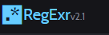
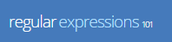
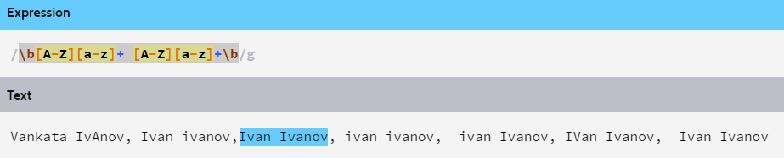
Problem: Match full name
You are given a sequence of words
Find those who are full names
You can use RegXr or Regex101

Slide 12
Grouping Constructs
(subexpression) - captures the matched subexpression and assigns it a number
(?:subexpression) – Defines a non-capturing group
\d{2}-(\w{3})-\d{4}
=>
22-Jan-2015
^(?:Hi|hello),\s*(\w+)$
=>
Hi, Peter

Slide 13
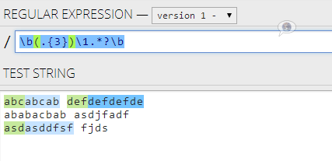
Backreference Constructs

Slide 14
Backreference Constructs
\number – matches the value of a numbered subexpression
\k<name> – matches the value of a named expression
22-12-2015
05/08/2016
\d{2}(-|\/)\d{2}\1\d{4}
=>
22-12-2015
05/08/2016
\d{2}(?<del>-|\/)\d{2}\k<del>\d{4}
=>

Slide 15

Playing with RegEx
Exercises in class

Slide 16
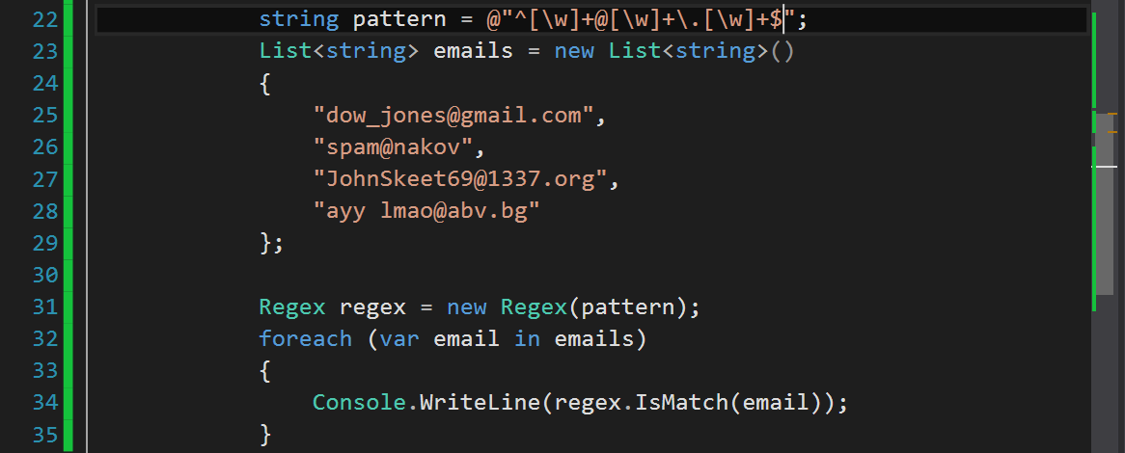
Regular Expressions
Using Built-In Regex Classes

Slide 17
Regex
Python supports a built-in regular expression library - re
import re
pattern = "A\w+"
regex = re.compile(pattern)
regex = r"A\w+"

Slide 18
Validating String By Pattern
determines whether the text matches the pattern:
text = "Today is 2015-05-11"
pattern = r"\d{4}-\d{2}-\d{2}"
regex = re.compile(pattern)
containsValidDate = (re.findall(text) != [])
print(containsValidDate) # True

Slide 19
Checking for Matches
Re.findall(pattern, text) – returns a collection of matching strings that correspond to the pattern
text = "Nakov: 123, Branson: 456"
regex = r"([A-Z][a-z]+): (\d+)"
matches = re.findall(regex, text)
print("Found {} matches".format(len(matches)))
for match in matches:
print("Name:", match[0])
# Found 2 matches
# Name: Nakov
# Name: Branson

Slide 20
Replacing With Regex
re.replace(pattern, replacement, text) – replaces all strings that match the pattern with the provided replacement
text = "Nakov: 123, Branson: 456"
pattern = r"\d{3}"
replacement = "999"
result = re.sub(pattern, replacement, text)
print(result)
# Nakov: 999, Branson: 999

Slide 21
Problem: Replace <a> tag
You are given a html text.
Replace all <a> tags in it with [URL].
<ul> <li> <a href="http://softuni.bg">SoftUni</a>
</li> </ul>
<ul> <li> [URL href="http://softuni.bg"]SoftUni[/URL]
</li></ul>
Check your solution here: https://judge.softuni.bg/Contests/Practice/Index/320#7

Slide 22
Solution: Replace <a> tag
text = input()
while text != "end":
pattern = r"<a.*?href.*?=(.*)>(.*?)<\/a>"
replace = "[URL href=$1]$2[/URL]"
replaced = re.replace(pattern, replace, text)
print(replaced)
text = input()
Notes:
You can try also: @"<a.*href=((?:.|\n)*?(?=>))>((?:.|\n)*?(?=<))<\/a>"

Slide 23
Splitting With Regex
pattern.split(text) – splits the text by the pattern
Returns list of string
text = "1 2 3 4"
pattern = r"\s+"
results = pattern.split(text)
print(", ".Join(results)) # 1, 2, 3, 4

Slide 24
Built-in RegEx
Exercises in class

Slide 25

Summary
Strings are immutable sequences of
characters
Changes to the string create a new object,
instead of modifying the old one
StringBuilder offers good performance
Regular expressions describe patterns for
searching through text
Define special characters, operators and
constructs for building complex patterns

Slide 26








Regular Expressions (RegEx)
https://softuni.bg/courses/programming-fundamentals

Slide 27

License
This course (slides, examples, demos, videos, homework, etc.) is licensed under the "Creative Commons Attribution-NonCommercial-ShareAlike 4.0 International" license
Attribution: this work may contain portions from
"Fundamentals of Computer Programming with C#" book by Svetlin Nakov & Co. under CC-BY-SA license
"C# Part I" course by Telerik Academy under CC-BY-NC-SA license
"C# Part II" course by Telerik Academy under CC-BY-NC-SA license

Slide 28




Trainings @ Software University
Software University Foundation – softuni.org
Software University – High-Quality Education, Profession and Job for Software Developers
softuni.bg
Software University @ Facebook
facebook.com/SoftwareUniversity
Software University Forums – forum.softuni.bg

